Slide 1
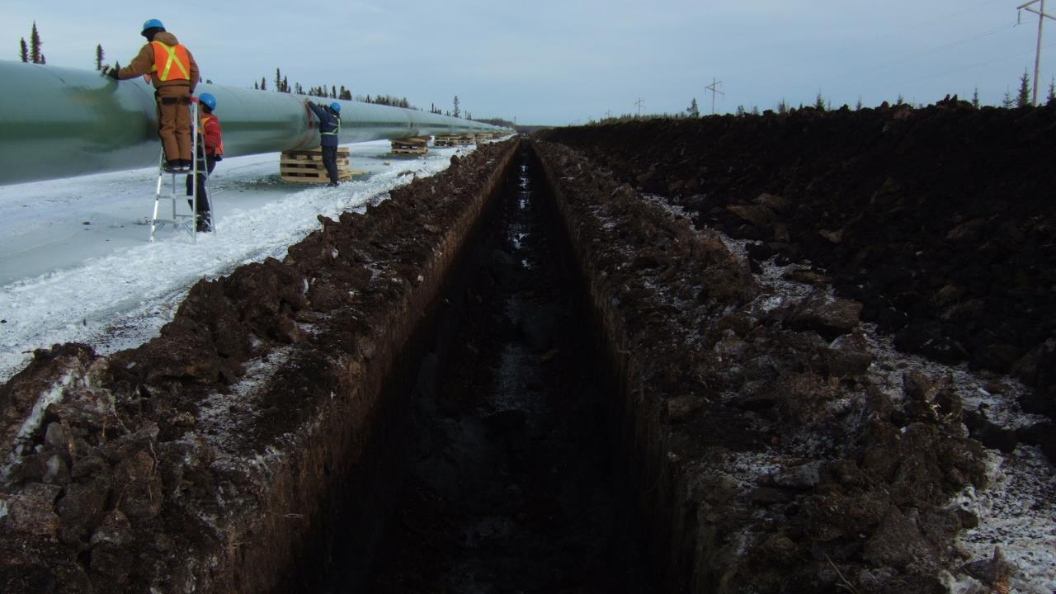
Environmental Management and Permitting
ENVE 644:
U.S. Fish and Wildlife Service’s
Environmental Review and Permitting
Bob Henszey
U.S. Fish and Wildlife Service
Conservation Planning Assistance
bob_henszey@fws.gov
April 1, 2020
Alberta Gas Pipeline
February 2012
Notes:
Brett Nelson of DOT&PF suggested you might be able to give a talk to a course I teach: ENVE 644, Environmental Management and Permitting. The class meets 5:30 to 8:30, Wednesdays. The students have varied backgrounds, but they would in interested in any permitting issues. We cover the ESA as a planning matter, even if not a permit, per se. If you can give a talk to my class about ESA, or your other permitting experiences, please let me know. The talk might be 20 to 30 minutes, and there are always questions.
Dr. Robert A. Perkins, PE
Professor and Chair, Civil and Environmental Engineering

Slide 2
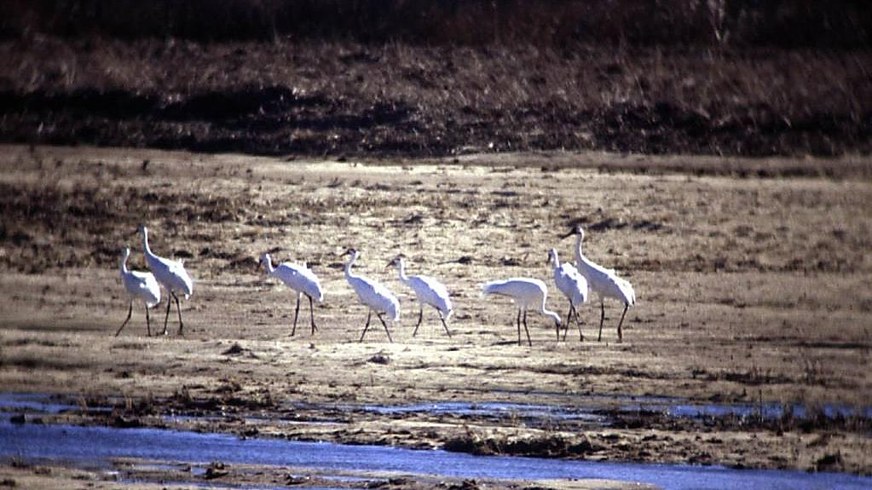
Mission of U.S. Fish and Wildlife Service
To work with others to conserve, protect and enhance fish, wildlife and plants and their habitats for the continuing benefit of the American people.
Endangered Whooping Cranes
Platte River, Nebraska
Notes:
https://www.fws.gov/help/about_us.html
Photo by Bob Henszey

Slide 3
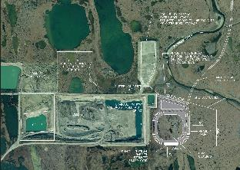
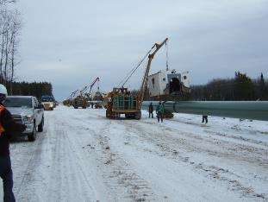
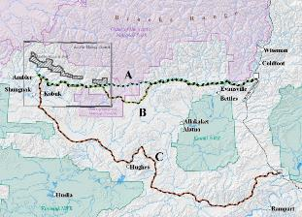
Authorities
Used Most Often in Alaska
Fish and Wildlife Coordination Act (FWCA)
Migratory Bird Treaty Act (MBTA)
Endangered Species Act of 1973 (ESA)
Marine Mammal Protection Act (MMPA)
Bald & Golden Eagle Protection Act (BGEPA)
Clean Water Act (CWA)
Federal Power Act (FPA)
Clean Air Act (CAA)
National Environmental Policy Act (NEPA)
National Historic Preservation Act (NHPA)
Notes:
These are the authorities we use most often in Alaska.
Acts the USFWS has the Lead:
The FWCA provides the basic authority for the USFWS's involvement in evaluating impacts to fish and wildlife from proposed water resource development projects, including wetlands. It requires that fish and wildlife resources receive equal consideration to other project features of water-resource development projects. It also requires Federal agencies that construct, license, or permit water resource development projects to consult with the USFWS (and the National Marine Fisheries Service in some instances) and state fish and wildlife agencies regarding anticipated impacts on fish and wildlife and measures to mitigate these impacts.
MBTA
ESA
MMPA
BGEPA
Acts the USFWS is Responsible for Trust Species:
The CWA establishes the USFWS's statutory authority as the Corps of Engineers’ principal consultant on fish, wildlife, and their habitat for Section 404 wetland permits, and for making recommendations to mitigate potential impacts.
The FPA gives the USFWS the authority to prescribe mandatory conditions for the protection and utilization of federal lands, and to prescribe fishways, so the FERC must include these conditions and prescriptions in any license it issues for hydropower projects.
CAA
NEPA
NHPA

Slide 4
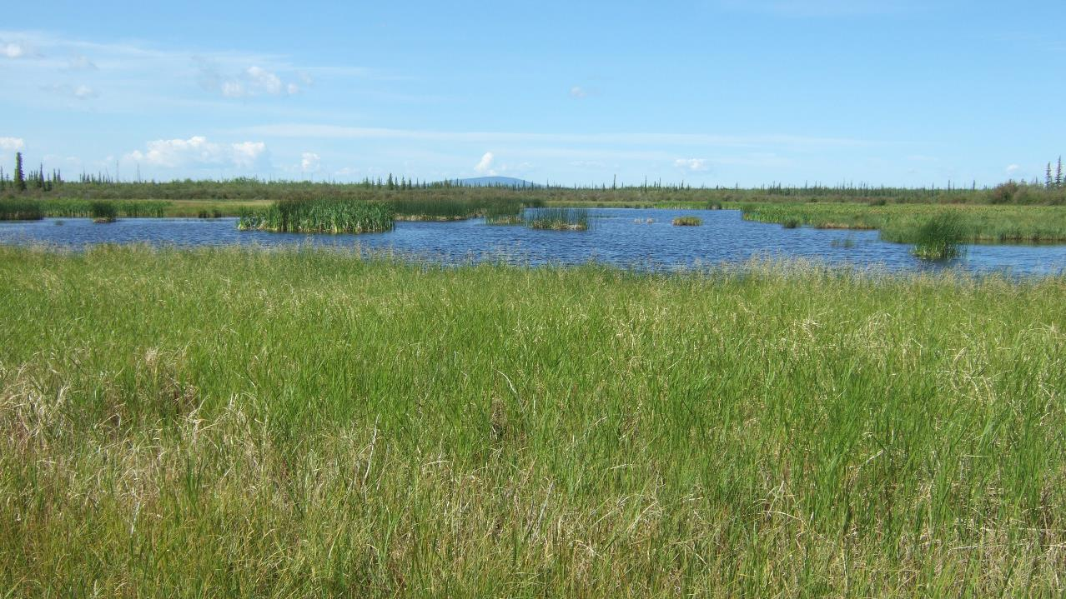
U.S. Fish and Wildlife Service
Select Programs
That Work With Construction Projects
U.S. Fish and Wildlife Service (Alaska Region)
National Wildlife Refuges
Many Other Programs ….
Migratory Birds Management
Ecological Services
Fisheries & Aquatic Conservation
Bald and Golden Eagle Permitting (BGEPA)
Migratory Bird Permitting (MBTA)
Marine Mammals Management (MMPA)
Endangered Species (ESA)
Conservation Planning Assistance (FWCA)
Fish Habitat Restoration & Partnerships (and other programs)
Yukon Flats
NWR
Notes:
Multiple programs within the USFWS specialize on specific environmental acts.
The National Wildlife Refuges permit activities on NWR, but project developers will likely work most often with Ecological Services and Migratory Birds.
Conservation Planning Assistance is often the first contact for project developers, so we can help direct them to the appropriate program if necessary while working through potential mitigation options.

Slide 5
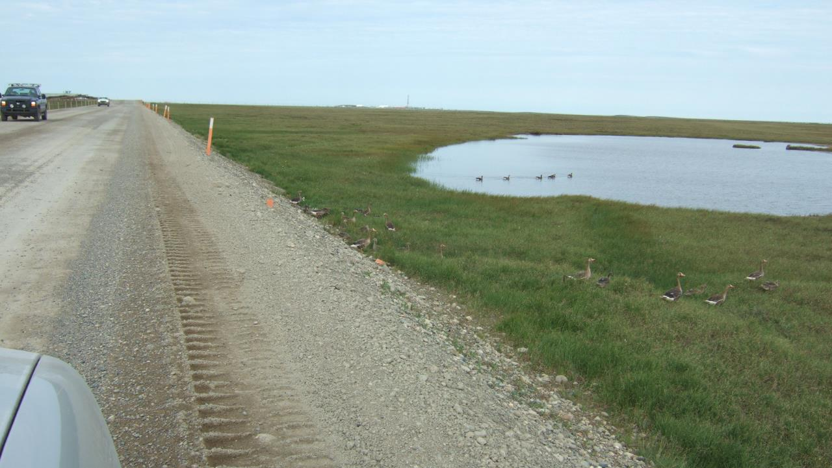
Mission of Conservation Planning Assistance (CPA)
The mission of CPA is to work collaboratively with industries, agencies and other stakeholders to achieve development goals in ways that are sustainable and compatible with the conservation of fish, wildlife and habitat.
North Slope
Spine Road
Notes:
CPA Fact Sheet: https://www.fws.gov/ecological-services/es-library/pdfs/Conservation_Planning.pdf

Slide 6
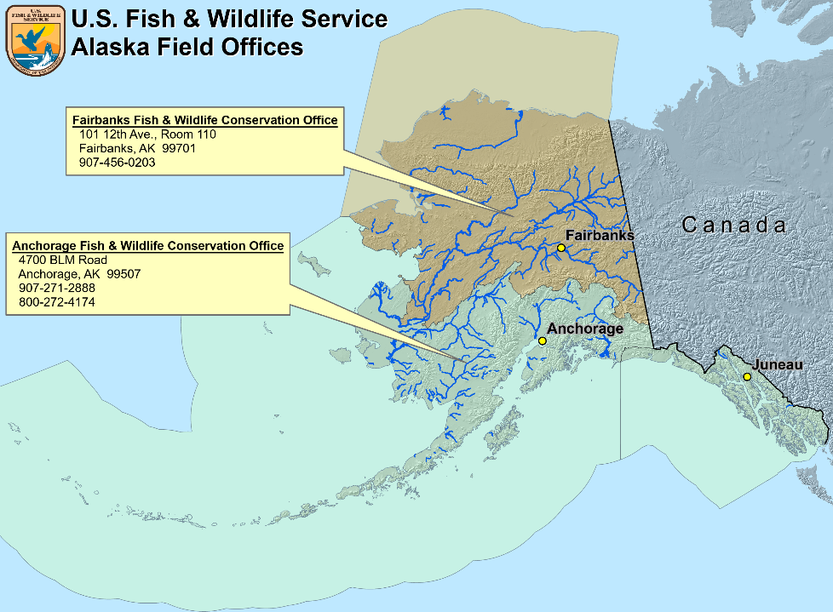
Notes:
Where do we work? Responsible for a huge area.

Slide 7
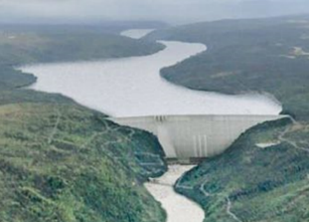
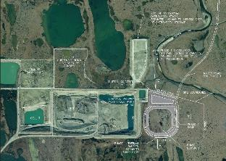
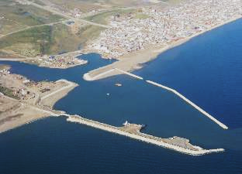
Susitna-Watana
Hydro Project
Fish and Wildlife Coordination Act (FWCA)
Provides the basic authority for the USFWS's involvement in evaluating impacts to fish and wildlife from proposed water resource development projects, including wetlands.
Requires fish and wildlife resources receive equal consideration to other project features of federally-funded water-resource development projects.
Requires Federal agencies to consult with the USFWS (and the National Marine Fisheries Service) and state fish and wildlife agencies regarding anticipated impacts on fish and wildlife and measures to mitigate these impacts.
Provides an opportunity for early coordination to influence project design before budgets are finalized, often sooner than other authorities.
But Recommendations Only, No Conditions
Wetland Projects
Fish and Wildlife Coordination Act Reports
Notes:
The FWCA provides the basic authority for the USFWS's involvement in evaluating impacts to fish and wildlife from proposed water resource development projects, including wetlands. It requires that fish and wildlife resources receive equal consideration to other project features of water-resource development projects. It also requires Federal agencies that construct, license, or permit water resource development projects to consult with the USFWS (and the National Marine Fisheries Service in some instances) and state fish and wildlife agencies regarding anticipated impacts on fish and wildlife and measures to mitigate these impacts.
The Fish and Wildlife Coordination Act (FWCA) is one of the oldest environmental laws aimed at protecting, conserving and developing wildlife resources and their habitats. The FWCA predates both the National Environmental Policy Act, the Endangered Species Act and many other current environmental laws. In fact, NEPA initially was proposed as an amendment to the Fish and Wildlife Coordination Act.
Pioneering environmental law (March 10, 1934).
Have the authority to investigate and prepare reports providing mitigation analyses on all water-related development projects.

Slide 8
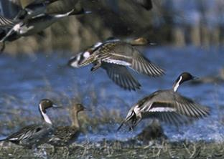
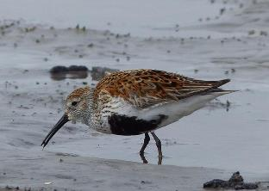
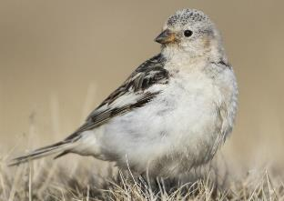
Migratory Bird Treaty Act (MBTA)
Makes it illegal for anyone to take, possess, import, export, transport, sell, purchase, barter, or offer for sale, purchase, or barter, any migratory bird, or the parts, nests, or eggs of such a bird except under the terms of a valid permit issued pursuant to Federal regulations.
Alaska Migratory Birds: Includes all birds except for grouse and ptarmigan (considered non-migratory), and species intentionally or unintentionally introduced by humans.
Based on treaties with Canada (1916), Mexico (1936), Japan (1972), and Russia (1976).
USFWS has the statutory authority and responsibility for enforcing the MBTA.
Northern Pintail (USFWS)
Dunlin (USFWS/Kristine Sowl)
Snow bunting
(USFWS/
Peter Pearsallish)
Notes:
Migratory Bird Treaty Act of 1918.
“parts” includes feathers.
Also includes hunting regulations, which are not discussed here.
Take: "to pursue, hunt, shoot, wound, kill, trap, capture, or collect, or attempt to pursue, hunt, shoot, wound, kill, trap, capture, or collect.“
Developed activity-specific guidance documents designed to help industry and project developers implement measures to reduce activity-specific impacts to migratory birds.
Guidance documents provide clarify standards and expectations, and/or offer suggested best practices to avoid or minimize negative impacts to birds.

Slide 9
Migratory Bird Treaty Act (MBTA)
Current Rule Making*
Focuses on the meaning of Take: "to pursue, hunt, shoot, wound, kill, trap, capture, or collect, or attempt to pursue, hunt, shoot, wound, kill, trap, capture, or collect."
M-Opinion (M-37050, 12/22/17) concluded:
MBTA's prohibitions on take apply when the purpose of an action is to take migratory birds, their eggs, or their nests (i.e., intentional).
However, conduct that results in the unintentional (incidental) injury or death of migratory birds is not prohibited by the MBTA.
* Public comment period closed March 19, 2020
Northern Pintail (USFWS)
Dunlin (USFWS/Kristine Sowl)
Snow bunting
(USFWS/
Peter Pearsallish)
Notes:
Migratory Bird Treaty Act of 1918.
“parts” includes feathers.
Also includes hunting regulations, which are not discussed here.

Slide 10
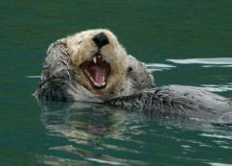
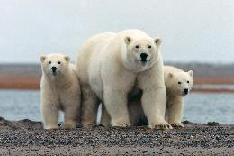
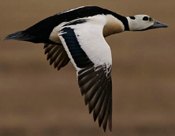
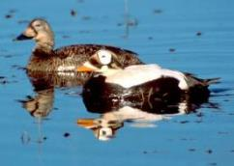
Endangered Species Act of 1973 (ESA)
Section 7 Consultation
Under section 7, Federal agencies must consult with USFWS to ensure that agency actions are not likely to jeopardize the continued existence of a listed species or destroy or adversely modify designated critical habitat.
Private individuals are affected by section 7 only when there is a federal nexus, e.g., they are receiving a Federal permit or funding.
Two consultation processes: Informal and Formal Consultation
Alaska’s Listed Threatened Species (each has designated critical habitat)
Northern Sea Otter
Polar Bear
Steller’s Eider
Spectacled Eider
Notes:
Both threatened and endangered species require consultation with the action agency.
Female polar bear with cubs (USFWS/Susi Miller)

Slide 11
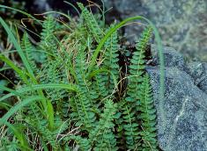
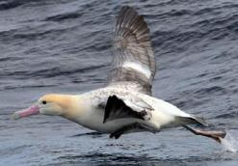
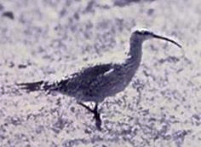
Endangered Species Act of 1973 (ESA)
Informal Consultation
Consultation usually begins as an “informal” consultation.
In the early stages of project planning, the Federal action agency (or designate) requests informal consultation. Discussions include which listed species occur in the proposed action area, and what effect the proposed action may have on those species.
If the Federal action agency determines the proposed action is not likely to affect any listed species in the project area, and if the USFWS concurs, the informal consultation is complete and the proposed project moves ahead.
Alaska’s Listed Endangered Species (no designated critical habitat)
Eskimo Curlew
(no confirmed sightings since 1963)
Wood Bison
(nonessential experimental population)
Aleutian Shield Fern
Short-tailed Albatross
Notes:
Both threatened and endangered species require consultation with the action agency.
Aleutian Shield Fern. Photo credit: Mike Boylan/USFWS
Short-tailed albatross. Photo Credit Yuri Artukin
The Eskimo curlew image represents one of the few images on record ever taken of the Eskimo curlew, taken by Don Bleitz on Galveston Island in 1962.
Pair of Wood Bison. Photo Credit: Laura Whitehouse

Slide 12
Endangered Species Act of 1973 (ESA)
Formal Consultation
When a Federal action agency determines its action is likely to adversely affect a listed species or its critical habitat, it submits a request for formal consultation.
During formal consultation, the USFWS and the action agency share information about the proposed project and the species and critical habitat(s) likely to be affected.
The USFWS has 90 days after receiving all pertinent information to determine whether the proposed activity will jeopardize* the continued existence of a listed species or destroy/adversely modify its critical habitat.
The USFWS then has 45 days after completion of formal consultation to write the biological opinion, concluding either jeopardy or no jeopardy for listed species (or adverse or no adverse modification of critical habitat).
* Under the ESA, “to jeopardize” means to engage in an action that reasonably would be expected, directly or indirectly, to reduce appreciably the likelihood of both the survival and recovery of a listed species in the wild by reducing the reproduction, numbers, or distribution of that species.
Notes:
Both threatened and endangered species require consultation with the action agency.

Slide 13
Endangered Species Act of 1973 (ESA)
What if Jeopardy or Adverse Modification?
The USFWS recommends reasonable and prudent alternatives of project implementation to avoid jeopardy or adverse modification.
The USFWS prepares an incidental take statement with reasonable and prudent measures to minimize the impacts of incidental take that is anticipated to result from implementing a project. These are non-discretionary, and must be undertaken by the action agency so they become binding conditions.
The action agency determines whether and how to proceed with its proposed action, and may:
Adopt the reasonable and prudent alternative(s);
Decide not to undertake the project (e.g., deny the permit);
Request an exemption from the Endangered Species Committee;
Reinitiate consultation based on modification of the action or development; or
Choose to take other action if it believes, upon review of the biological opinion and best available scientific information the action satisfies section 7(a)(2).

Slide 14
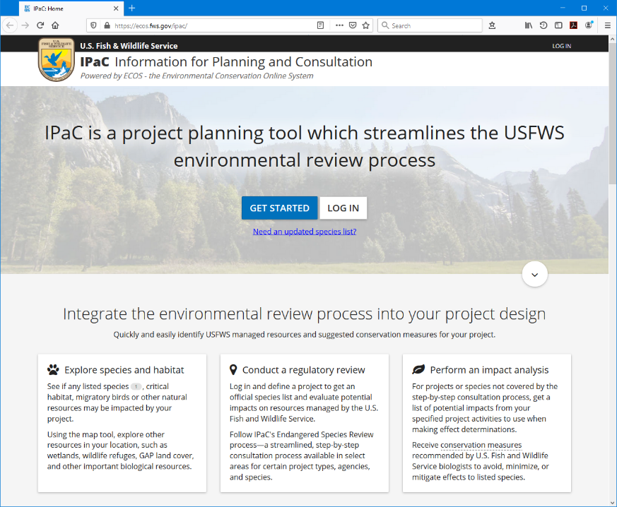
IPaC
Information for Planning and Consultation
A Good Place to Start
https://ecos.fws.gov/ipac/
Notes:
IPaC is a good starting point, and will provide an informal consultation letter where there are no listed species. However, the geographic ranges are not perfect, so it’s a good idea to check with the USFWS if your project is near the boundary for listed species or their critical habitat.

Slide 15
Marine Mammal Protection Act of 1972 (MMPA)
Alaska’s Marine Mammals Managed by the U.S. Fish and Wildlife Service
Pacific Walrus
Northern Sea Otter
Polar Bear
ESA Listed as Threatened
ESA Listed as Threatened
Not ESA Listed
The other marine mammals (whales, seals, sea lions, dolphins and porpoises) are managed by our sister agency the National Marine Fisheries Service.
The Act Prohibits, with certain exceptions, the take of marine mammals in U.S. waters.
Authorizes the incidental, but not intentional taking of small numbers of certain marine mammals associated with specified activities, provided the total of such taking will have no more than a negligible impact on these marine mammal species and does not have an unmitigable adverse impact on the availability of these species for subsistence uses.
Notes:
Both the Norther Sea Otter and the Polar Bear are listed as Threatened under the ESA. Pacific Walrus are not.
The other marine mammals (whales, seals, sea lions, dolphins and porpoises) are managed by our sister agency: National Marine Fisheries Service
Female polar bear with cubs (USFWS/Susi Miller)
Pacific walrus cows (USFWS/Joel Garlich-Miller)

Slide 16
Marine Mammal Protection Act of 1972 (MMPA)
ITRs and IHAs
Two types of authorizations are available. Incidental Take Regulations (ITR) can be issued for up to five years; and if the taking is limited to harassment, an Incidental Harassment Authorization (IHA) can be issued for up to one year.
Activities authorized under ITRs and IHAs must adopt measures to minimize any adverse impacts to marine mammals; their habitat, and their availability for Alaska Native subsistence use.
ITRs and IHAs also specify monitoring and reporting requirements which provide a basis for evaluating potential impacts of current and future activities on marine mammals.

Slide 17
Marine Mammal Protection Act of 1972 (MMPA)
More on ITRs
If ITRs are promulgated for a specified activity in a specified geographical region U.S. citizens can request a Letter of Authorization (LOA) from the USFWS to carry out these activities under an exemption of the MMPA on a project-specific basis.
Depending upon the nature, location and timing of the proposed activity, ITR applicants may be required to consult with potentially affected subsistence communities, and develop additional mitigation measures to address potential impacts to subsistence users.

Slide 18
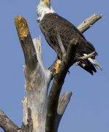
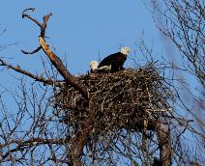
Bald & Golden Eagle Protection Act (BGEPA)
Prohibits taking* eagles, including their parts, nests or eggs without a permit.
Two types of permits are issued:
Permits associated with development projects or other activities that may impact eagles or their nests when the applicant is unable to minimize or prevent disturbance to bald or golden eagles; and
Permits to take, possess, and transport bald and golden eagles for scientific, educational, and Indian religious purposes, depredation, and falconry (golden eagles).
* Take includes pursue, shoot, shoot at, poison, wound, kill, capture, trap, collect, molest or disturb. Disturb means to agitate or bother a bald or golden eagle to a degree that causes, or is likely to cause, based on the best scientific information available, to injure an eagle, decrease its productivity, or abandon a nest.
Bald Eagle
Golden Eagle
Nests are protected too
Notes:
Bald Eagle: Katherine Whitmore, USFWS
Golden Eagle: No credit, https://www.fws.gov/birds/management/managed-species/bald-and-golden-eagle-information.php
Bald Eagle Nest: Glades Wildlife Refuge, 2013, https://natlands.org/news/bald-eagles/

Slide 19
Bald & Golden Eagle Protection Act (BGEPA)
Permits for development projects or other activities
Permits may be issued to take bald eagles and golden eagles where the taking is associated with but not the purpose of the activity, and cannot practicably be avoided. Most take under this section will be in the form of disturbance, however, permits may authorize non-purposeful take that may result in mortality.
Permits may be issued for removing eagle nests where:
Necessary to alleviate a safety emergency to people or eagles,
Necessary to ensure public health and safety,
The nest prevents the use of a human-engineered structure, or
The activity or mitigation for the activity will provide a net benefit to eagles.
Only inactive nests may be taken, except in the case of safety emergencies.

Slide 20
Bald & Golden Eagle Protection Act (BGEPA)
Additional Considerations
All permittees will be required to avoid and minimize the potential for take to the degree practicable, and for programmatic permits, to the point where take is unavoidable.
Additional compensatory mitigation may be required for:
Programmatic take and other multiple take authorizations;
Disturbance associated with the permanent loss of a breeding territory or important traditional communal roost site; or
As necessary to off-set impacts to the local area population.
Basic recommendations to help minimize the potential for disturbing bald eagles: National Bald Eagle Management Guidelines (https://www.fws.gov/r7/eaglepermit/pdf/national_guidelines.pdf)

Slide 21
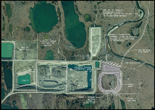
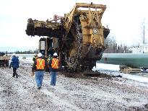
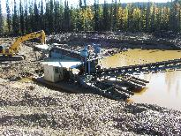
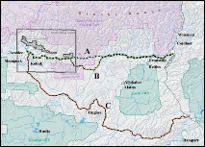
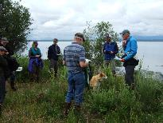
Clean Water Act (CWA)
The Corps of Engineers has the sole responsibility for making final permit decisions.
The CWA establishes the USFWS's statutory authority as the Corps of Engineers’ principal consultant on fish, wildlife, and their habitat for Section 404 wetland permits, and for making recommendations to mitigate* potential impacts.
The USFWS is automatically included on wetland bank and in-lieu fee third party provider interagency review teams (IRT).
Authority to elevate specific permit decisions involving aquatic resources of national importance (ARNI) for review by the Assistant Secretary of the Army for Civil Works and the Assistant Secretary for Fish and Wildlife and Parks.
* Mitigation: avoid, minimize, and compensate for unavoidable loss of wetland functions.
Gravel Mines
Ambler Road
Interagency Review Teams
Pipelines
Placer Mines

Slide 22
Authorities
Used Most Often in Alaska
Fish and Wildlife Coordination Act (FWCA)
Migratory Bird Treaty Act (MBTA)
Endangered Species Act of 1973 (ESA)
Marine Mammal Protection Act (MMPA)
Bald & Golden Eagle Protection Act (BGEPA)
Clean Water Act (CWA)
Federal Power Act (FPA)
Clean Air Act (CAA)
National Environmental Policy Act (NEPA)
National Historic Preservation Act (NHPA)
Notes:
Time check, do we have time/interest in covering these additional acts?
These are the authorities we use most often in Alaska.
Acts the USFWS has the Lead:
The FWCA provides the basic authority for the USFWS's involvement in evaluating impacts to fish and wildlife from proposed water resource development projects, including wetlands. It requires that fish and wildlife resources receive equal consideration to other project features of water-resource development projects. It also requires Federal agencies that construct, license, or permit water resource development projects to consult with the USFWS (and the National Marine Fisheries Service in some instances) and state fish and wildlife agencies regarding anticipated impacts on fish and wildlife and measures to mitigate these impacts.
MBTA
ESA
MMPA
BGEPA
Acts the USFWS is Responsible for Trust Species:
The CWA establishes the USFWS's statutory authority as the Corps of Engineers’ principal consultant on fish, wildlife, and their habitat for Section 404 wetland permits, and for making recommendations to mitigate potential impacts.
The FPA gives the USFWS the authority to prescribe mandatory conditions for the protection and utilization of federal lands, and to prescribe fishways, so the FERC must include these conditions and prescriptions in any license it issues for hydropower projects.
CAA
NEPA
NHPA

Slide 23
Federal Power Act (FPA)
Gives the Federal Energy Regulatory Commission (FERC) the authority to issue licenses for non-federal hydropower projects.
Each FERC license must include conditions to protect, mitigate, and enhance fish and wildlife affected by the project based on recommendations from the USFWS, NOAA-Fisheries, and state fish and wildlife agencies.
The Secretaries of Interior and Commerce share mandatory conditioning authority to require the construction, operation, and maintenance of fishway passages.
On federal land, licenses must be consistent with the purpose for which the federal reservation was set aside, and comply with conditions set forth by the Secretary of the Department responsible for managing the federal reservation.
Should the FERC not adopt these recommendations, they are obligated to explain why and to offer an opportunity for dispute resolution prior to making their final decision.
Susitna-Watana
Hydro Project
Notes:
FERC is the only “agency” where it took an Act of Congress to tell it that it had to comply with the FWCA.
Non-federal hydropower projects allows FERC to regulate hydropower projects on private and state land.
Federal land = federal reservation = public, tribal, etc.
FERC must give “equal consideration” to developmental and non-developmental values in its licensing decisions.
Licenses last for 30-50 years, with the licenses of many projects near expiration (or already expired), relicensing provides an opportunity to assess and mitigate environmental impacts.
This looks like a nice summary included with summary of FERC economic methodology: www.fws.gov/policy/hydrochap1.pdf

Slide 24
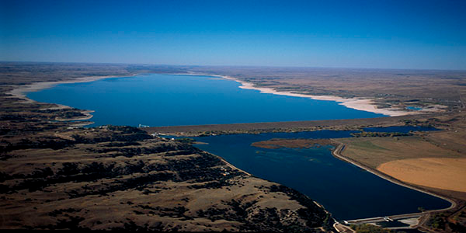
Federal Power Act (FPA)
Additional Considerations
The FERC must give “equal consideration” to developmental and non-developmental values in its licensing decisions.
Licenses last for 30-50 years, with the licenses of many projects near expiration (or already expired), relicensing provides an opportunity to assess and mitigate environmental impacts.
FERC Relicensing Lake McConaughy’s Kingsley Dam
North Platte River, NE
Required Considering Downstream Whooping Crane Habitat Having the Same Value as Hydropower and Irrigation Water
Notes:
Kingsley Dam and Lake McConaughey: Central Nebraska Public Power and Irrigation District
Whooping Cranes on the Platte River near Grand Island, Nebraska: Bob Henszey
Kingsley Dam was one of the first federal projects to be relicensed when the license expired.
The book Cadillac Desert by Marc Reisner has a detailed chapter discussing this irrigation, turned hydro, project.

Slide 25
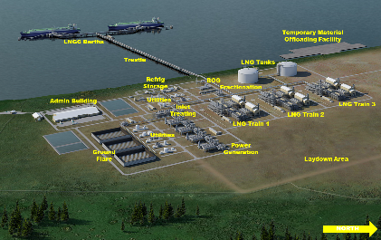
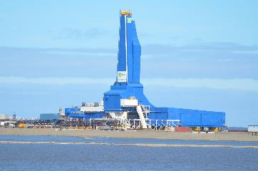
Clean Air Act (CAA)
Calls for the prevention and control of air pollution across the country and includes a national goal to “to preserve, protect and enhance the air quality in national parks, national wilderness areas, national monuments, national seashores, and other areas of special national or regional natural, recreational, scenic or historic value”
Sets forth an affirmative duty to protect air quality and air quality related values (e.g., visibility and ecosystem resources) of national parks and wilderness areas designated as Class I areas under the statute by avoiding and minimizing impacts to such areas.
Provides for the banking and trading of emissions reductions and use of emission offsets to capture cost efficiencies.
Constructing Liberty Drill Rig
Proposed AK LNG Liquefaction Facility
Notes:
Constructing Liberty Drill Rig, North Slope: Bob Henszey (USFWS)
Proposed AK LNG Liquefaction Facility, Nikiski, Ak: Alaska Gasline Development Corporation
Alaska Maritime NWR has three Class I wilderness areas: Bering Sea Wilderness, Simeonof Wilderness, and Tuxedni Wilderness. Not sure about Arctic NWR or the other Alaska NWRs.

Slide 26
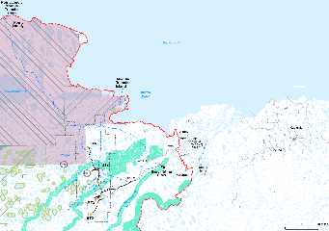
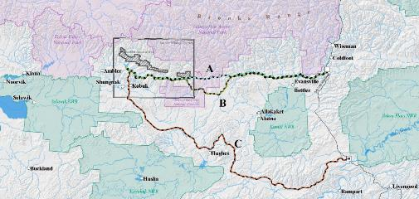
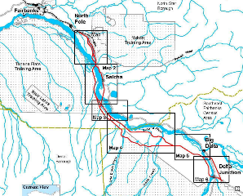
National Environmental Policy Act (NEPA)
Applies to all Federal agencies.
Required to analyze the environmental impacts of proposed actions that may significantly impact the environment.
Required to include appropriate mitigation measures not already included in the proposed action.
Agency decisions must state whether all practicable means to avoid and minimize environmental harm from the alternative selected have been adopted, and if not, why they were not.
Willow Master
Development Plan EIS
Proposed Ambler Road EIS
Proposed Northern Rail Extension EIS
Notes:
The USFWS was not the lead on these projects, but CPA provided mitigation recommendations for fish, wildlife, and their habitats.

Slide 27
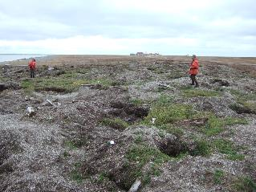
National Historic Preservation Act (NHPA)
Requires Federal agencies under Section 106 to take into account the effects of their undertakings on historic properties.
Federal agencies are required to consult with State/Tribal Historic Preservation Officers, Indian tribes or Native Hawaiian Organizations, local governments, interested parties such as historic preservation advocacy organizations, the public, and the Advisory Council on Historic Preservation (ACHP).
Section 110(f) specifically addresses mitigation of adverse affects to properties of national significance, requiring that, to the maximum extent possible, undertake such planning and actions as may be necessary to minimize harm to such landmark.
For proposed projects: most often applied to National Wildlife Refuge right-of-ways involving archaeological and historic sites.
Plundered Archeological Site
(not on a NWR)
Notes:
Plundered archeological site not on a NWR, Bob Henszey (USFWS)

Slide 28
Questions?

